Slide 1




MOST IMPORTANT TOPICS
DR. RAJENDRA PRASAD GS-1, PRELIMS
HORNBILL FESTIVAL AND STATEHOOD DAY OF NAGALAND PRELIMS, INTERVIEW
INDIGENOUS FAITH DAY PRELIMS
MOUNT MERAPI PRELIMS

Slide 2
PRELIMS PRACTICE QUESTION
Q. Regarding “carbon credits”, which one of the following statements is not correct? (UPSC-2011)
(a) The carbon credit system was ratified in conjunction with the Kyoto Protocol
(b) Carbon credits are awarded to countries or groups that have reduced greenhouse gases below their emission quota
(c) The goal of the carbon credit system is to limit the increase of carbon dioxide emission.
(d) Carbon credits are traded at a price fixed from time to time by the United Nations Environment Programme.

Slide 3
PRELIMS PRACTICE QUESTION
Q. The centre of a cyclone is a calm area. It is called the ___ of the storm,
Arm
Heart
Eye
Head

Slide 4
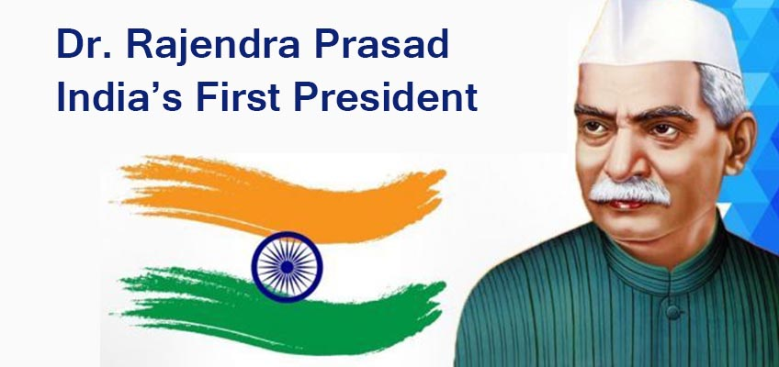
DR. RAJENDRA PRASAD

Slide 5
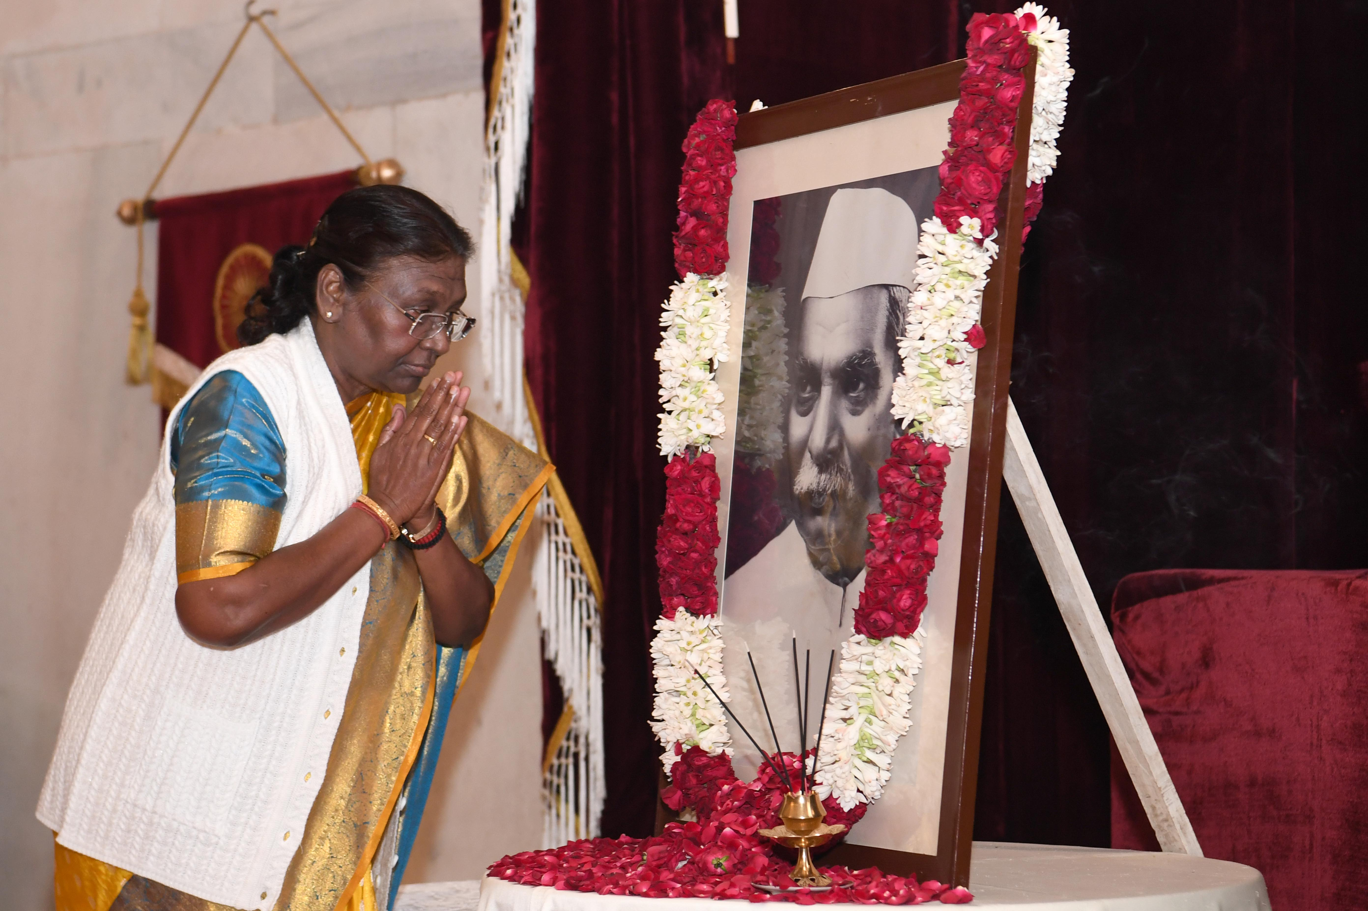
CONTEXT
The President of India, Smt Droupadi Murmu paid floral tributes to Dr. Rajendra Prasad, the first President of India on his birth anniversary at Rashtrapati Bhavan today (December 3, 2023).

Slide 6
ABOUT
Birth & early life : Dr. Rajendra Prasad was born on December 3, 1884, in Zeradei, Siwan, Bihar. His father was Mahadev Sahai.
Legal Career: Began his legal practice at the Patna High Court in 1916
Influence by Gandhi: Deeply influenced by Mahatma Gandhi, especially during the Champaran Satyagraha.

Slide 7
FREEDOM STRUGGLE INVOLVEMENT
Joined Indian National Congress in 1911.
Actively participated in the non-cooperation movement in Bihar.
Led a salt Satyagraha in Nakhas Pond, Bihar in 1930.
Leadership Roles in Congress:
  Presided over the Bombay session of the Congress in 1934.
  Succeeded Subhash Chandra Bose as Congress President in 1939.

Slide 8
CONSTITUENT ASSEMBLY AND PRESIDENCY
Elected President of the Constituent Assembly in 1946.
Oversaw committees on the National Flag and Rules of Procedure.
Became the first President of India on January 26, 1950.
Role in Interim Government
  Served as the Minister of Food & Agriculture in Pandit Jawaharlal Nehru's Interim Government in 1946.

Slide 9
ADDITIONAL FACTS
Awards and Recognition: Awarded the Bharat Ratna in 1962 after a 12-year presidency.
Literary Contributions: Authored books including "Satyagraha at Champaran," "India Divided” and his autobiography "Atmakatha”.
Death: Passed away on February 28, 1963, at the Sadaqat Ashram in Patna.

Slide 10

HORNBILL FESTIVAL AND STATEHOOD DAY OF NAGALAND

Slide 11
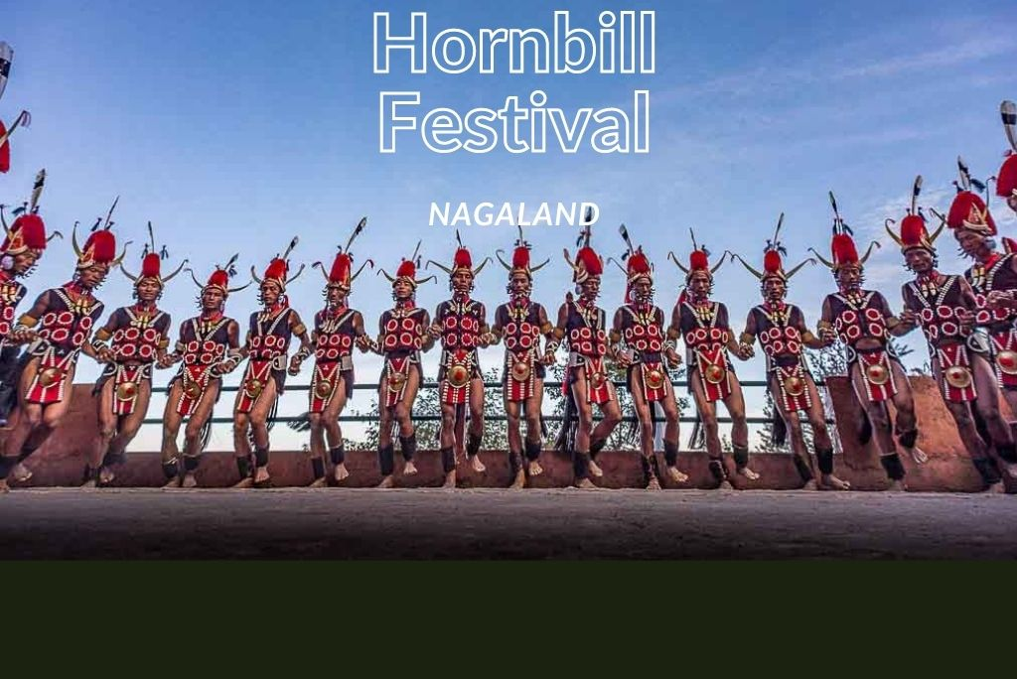
CONTEXT
Nagaland is celebrating the 24th edition of the Hornbill Festival.

Slide 12
EVENT DETAILS
An upcoming exhibition will showcase the Mithun (the official state animal) and the Tenyi Vo (a local breed of pig) from Nagaland's countryside. Additionally, the Nagaland Beekeeping and Honey Mission is initiating the inaugural 'Bee Tourism' event, highlighting the state's distinctive beekeeping heritage and the diverse methods employed throughout the region.

Slide 13
ABOUT THE HORNBILL FESTIVAL
Annual event in Nagaland, celebrating indigenous culture.
Started in 2000, showcasing traditional and contemporary heritage.
Named after the hornbill, a significant bird in local folklore.
Known as the 'Festival of Festivals' for its grand display of diversity.
Aims to promote inter-tribal interaction and cultural preservation.
Organized by Nagaland's State Tourism and Art & Culture Departments.

Slide 14
STATEHOOD OF NAGALAND:BACKGROUND (UNTIL 1957)
Originally a district in Assam known as ‘The Naga Hills’.
Formation of Naga People’s Convention (NPC) (1957)
August 1957: Various Naga tribe leaders formed NPC.
Demand for Separate State (1960):
  July 1960: NPC delegation met the then Prime Minister, demanding a separate state within the Indian Union, named ‘Nagaland’.

Slide 15
4th September 1962: The State of Nagaland Act, 1962 was passed following Presidential assent.
December 1, 1963: Nagaland was inaugurated as the 16th state of India.
December 1 is celebrated as Nagaland Statehood Day annually.

Slide 16
PRELIMS PRACTICE QUESTION
Q. Which Article of the Constitution states special provisions with respect to the State of Nagaland?
(a) Article 352
(b) Article 356
(c) Article 370
(d) Article 371 A

Slide 17
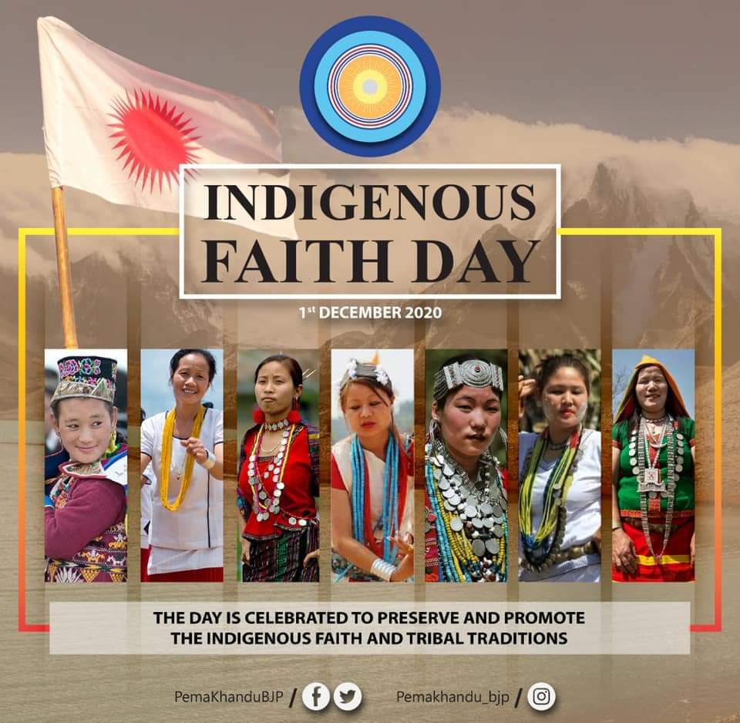
INDIGENOUS FAITH DAY

Slide 18
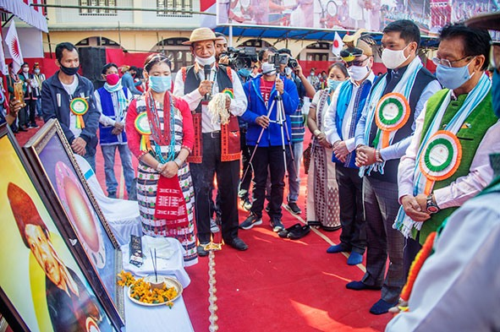
CONTEXT
Indigenous Faith Day, celebrated in Arunachal Pradesh on December 1st annually, holds significant importance in preserving and promoting the diverse indigenous beliefs and practices of the region

Slide 19
KEY FACTS
Arunachal Pradesh is home to over 100 ethnic tribal subgroups, each with its own unique language and dialect.
Approximately 25% of the people in Arunachal Pradesh practice an indigenous religion known as "Donyi-Polo" (Sun-Moon).
The state has a diverse religious composition, with Christianity being the majority religion (30%), followed closely by Hinduism (29%).

Slide 20
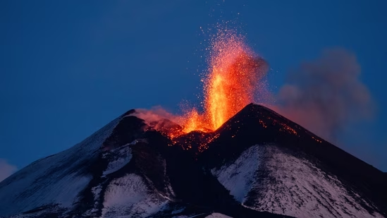
MOUNT MARAPI

Slide 21
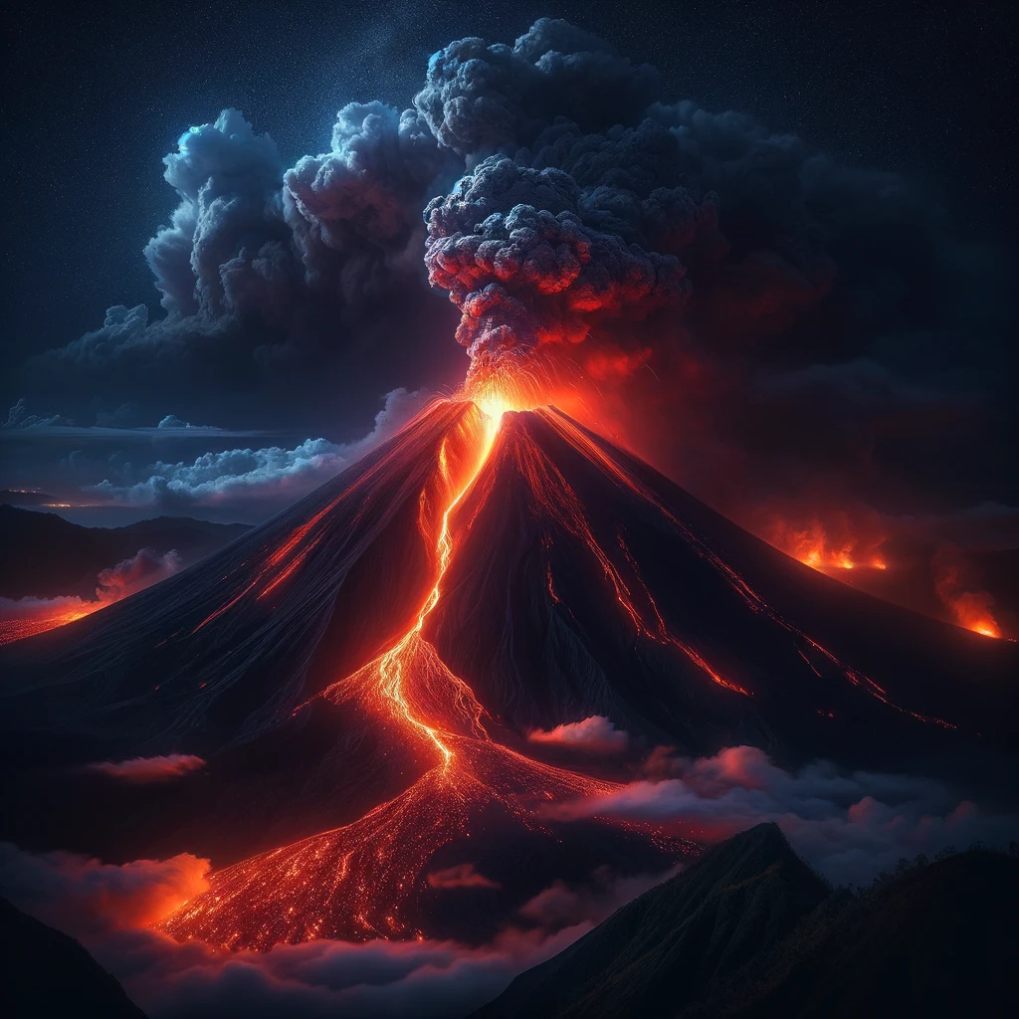
CONTEXT
Indonesia's Mount Marapi erupted with white-and-gray ash plumes on 3rd of December 2023

Slide 22
KEY FACTS
Mount Merapi, an active stratovolcano located on the border between Central Java and the Special Region of Yogyakarta, erupted, sending ash plumes over 3,000 meters (9,800 feet) into the air. This eruption was part of its regular activity, as Merapi is known for its frequent eruptions.
Merapi, active since 1548, derives its name from Sanskrit and Javanese words for 'mountain' and 'fire', reflecting regional cultural integration.

Slide 23
PRELIMS PRACTICE QUESTION
Q.Which of the following types of volcanoes is characterized by highly explosive eruptions and steep-sided profiles?
a) Shield volcano
b) Stratovolcano
c) Cinder cone
d) Lava dome
Select the correct answer using the codes below:
A) Only a and b
B) Only b and c
C) Only b
D) Only c and d

Slide 24
By the Officers,​
For the Officers

